Slide 1
Lecture 4 Introduction to Machine Learning ⇨ Goal-Oriented Systems
András Lőrincz
Department of Artificial Intelligence
Faculty of Informatics

Slide 2
Intelligence
In order to be seen, intelligence has to act
in a meaningful way
for survival
in interaction with other species
Goals:
survival – long term goals
evolutionary selection → descendants
competition – fitness
strength, safety
food
defend children

Slide 3
The basic setting
environment
state
action
reward
agent
strategy,
model

Slide 4
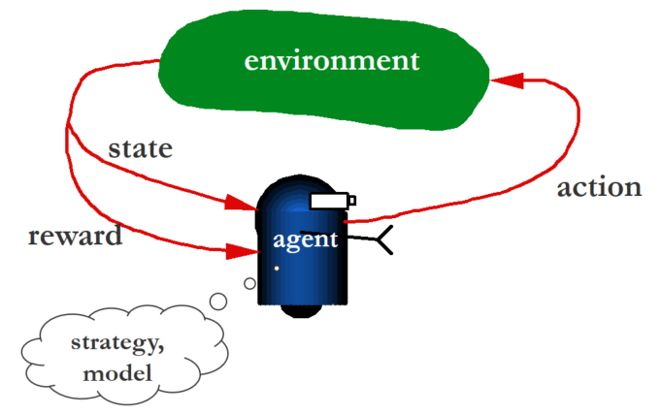
Elements of goal-oriented learning
environment is a (special) black box
learning agent
state: is the observation of the agent about the environment
reward: is a single number (!!!) that may change from time to time
strategy: is a mapping that belongs to the agent. It renders actions to the states:
action: can modify the environment
optimization task: find out the strategy that gives rise to the most cumulated reward in the long run

Slide 5
Assumptions
reward is a single number in each time instant
time is discrete ( t = 1, 2, 3, …)
state space is discrete and finite
state is fully observed
plus: Markov property – see later
issue: are not these constraints too strong?

Slide 6






Formalizing the problem I
time:
state:
action:
reward:
startegy:
deterministic:
stochastic:
π(s,a) (= π(a|s)) is the probability that the agent’s action is a in state s. Recall the concept of conditional probability

Slide 7

Formalizing the problem II
interaction:
model of the environment: transition probabilities and rewards
goal: maximize the expected value of the cumulated reward:
Recall the concept of the expectation value

Slide 8
The Markov-assumption
We assume that the PAST DOES NOT COUNT:
The transition probability matrix
is called the dynamics of the environment.
task: find the optimal strategy

Slide 9
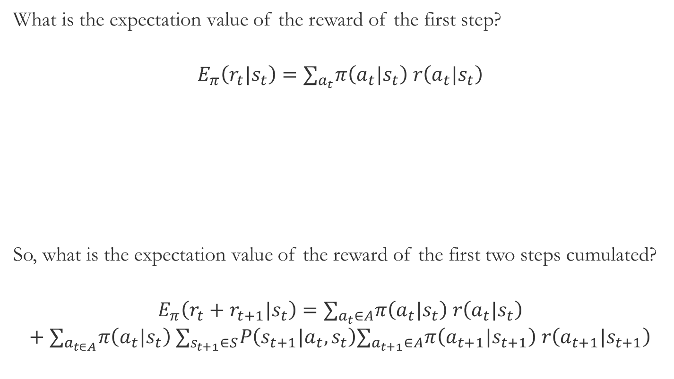
We start at time t from state s_{t}, use strategy π(a_{t}|s_{t}) to draw the next action a_{t} and to receive reward r(a_{t}|s_{t})
What is the expectation value of the reward of the first step?
$$E_{π}\left(r_{t}|s_{t}\right)=∑_{a_{t}}π\left(a_{t}|s_{t}\right) r\left(a_{t}|s_{t}\right)$$
So, what is the expectation value of the reward of the first two steps cumulated?
$$E_{π}\left(r_{t}+r_{t+1}|s_{t}\right)=∑_{a_{t}∈A}π\left(a_{t}|s_{t}\right) r\left(a_{t}|s_{t}\right)$$
$${+ ∑}_{a_{t∈A}}π\left(a_{t}|s_{t}\right) ∑_{s_{t+1}∈S}P\left(s_{t+1}|a_{t},s_{t}\right)∑_{a_{t+1}∈A}π\left(a_{t+1}|s_{t+1}\right) r\left(a_{t+1}|s_{t+1}\right)$$
We start at time t from state s_{t}, use strategy π(a_{t}|s_{t}) to decide to use action a_{t} or any other action, and happen to receive reward r_{t} and go further to learn that we are in state s_{t+1}, and so on…

Slide 10
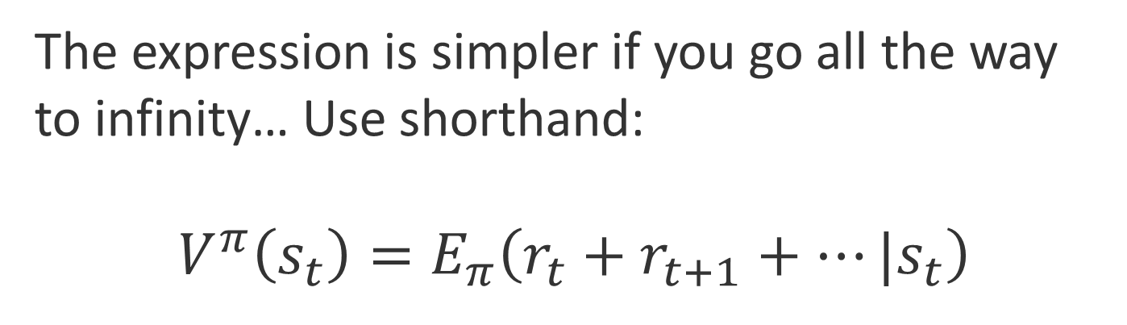
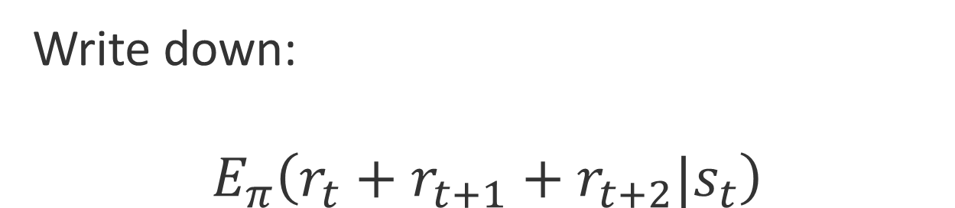
Write down: $$E_{π}\left(r_{t}+r_{t+1}+r_{t+2}|s_{t}\right)$$
The expression is simpler if you go all the way to infinity… Use shorthand:
$${V^{π}\left(s_{t}\right)=E}_{π}\left(r_{t}+r_{t+1}+…|s_{t}\right)$$

Slide 11
How to learn the optimal strategy?
This is the topic of reinforcement learning
Learn the strategy
when the model of the environment (i.e., transition probability matrix and reward vector) is given
when they are not given but should be estimated
An intriguing finding
The best method of reinforcement learning called ”temporal difference learning” has been found in monkeys. The dopamine system is responsible for it.
Mammals seem to use this learning method for the optimization of behavior
It seems that only the learning of components is to be discovered, or possibly improved to be able to meet human intelligence or more…
BUT: computers are fast…

Slide 12
Reinforcement learning → (re-)sources
CS234: Reinforcement Learning Winter 2020
http://web.stanford.edu/class/cs234/index.html
A great step was made by the introduction of deep learning methods into Reinforcement Learning
Advanced AI: Deep Reinforcement Learning in Python
https://bit.ly/2p6jWrh
Readings
Deep Reinforcement Learning: Pong from Pixels
http://rll.berkeley.edu/deeprlcourse/
Suggested starting point
Sutton and Barto: Introduction to RL
https://webdocs.cs.ualberta.ca/~sutton/book/the-book.html

Slide 13
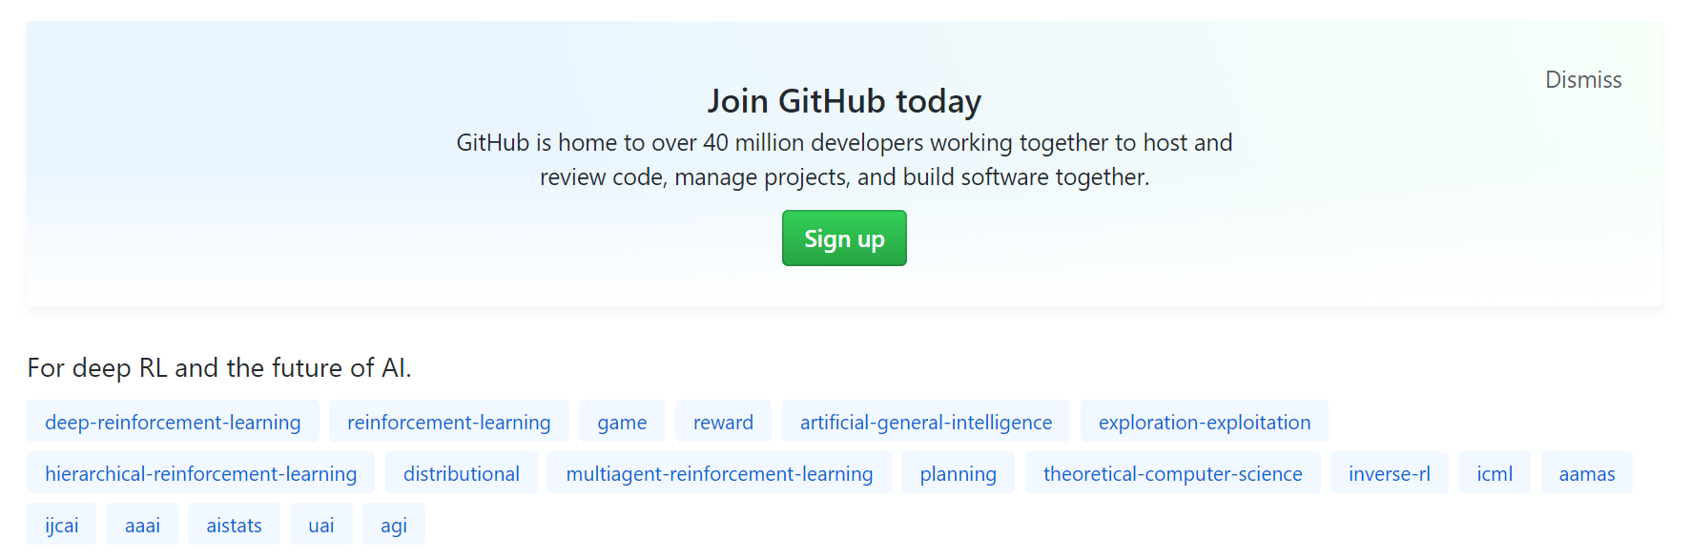
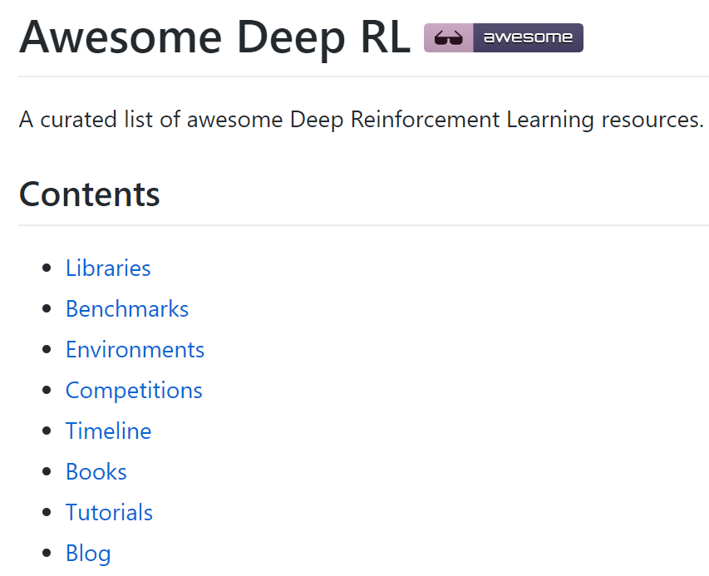
Results of reinforcement learning

Slide 14
Examples
https://deepmind.com/blog/article/deep-reinforcement-learning
https://neptune.ai/blog/reinforcement-learning-applications
7 Real-Life Applications of Reinforcement Learning (RL)
Applications in self-driving cars
Industry automation with Reinforcement Learning
RL applications in trading and finance
RL in NLP (Natural Language Processing)
RL in gaming
RL applications in marketing and advertising
RL in robotics manipulation

Slide 15

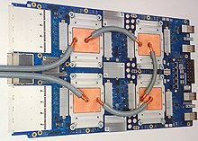
RL in Gaming
AlphaZero
chess
shogi
go
AlphaZero trained using 5,000 tensor processing units (TPUs) and ran on four TPUs and a 44-core CPU in its matches.^{[19]}
You can find software on GitHub
Chess, go, and so on
Poker

Slide 16
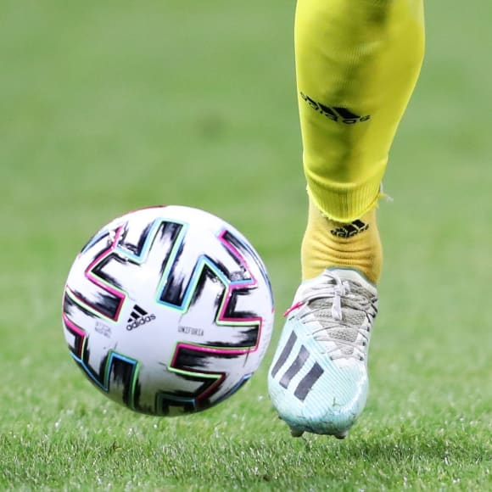

Markov assumption is fulfilled in chess & GO
but not in Poker and not in general….
Can you tell which direction to move your leg?
Data:
speed of ball 20 m/s (best runners: 40 km/h ~ 100m/10s)
speed of your leg 10 m/s = 1 m/100ms
distance to ball: 20cm
size of ball: 22cm
Depends on:
previous position
present position
distance to leg
distance to earth…
physics – direction of gravity
wind
rotation of the ball
time: t-1
time: t

Slide 17
Markov assumption is not fulfilled in general….

Slide 18
More details in the homeworks

Slide 19
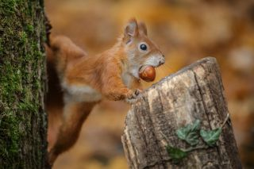
„Long-term goals” in nature
Actions to reach long-term goals
Squirrels
nut hiding behavior
they pretend to bury nuts when other squirrels are watching
they go to secret locations to hide nuts
Inherited or learned?
Planned or prewired?
It is prewired...
It is amazing that
genetics can do this
On the other hand:
Why not?

Slide 20
More agents?
Competition: who is stronger, faster?
Collaboration?
communication?
signal? → e.g., yes/no – barkochba
worksharing → needs planning
cheating, exploitation, selfishness, selflessness
What goes on in the head of the partner?

Slide 21
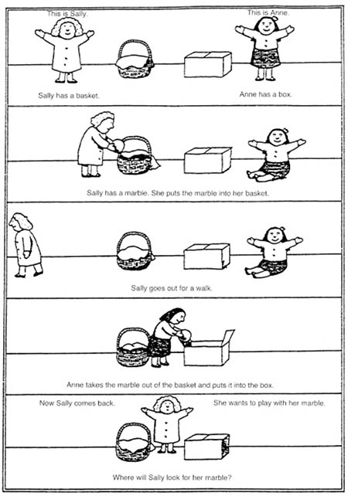
Theory of mind – false beliefs
23 of the 27 clinically unimpaired children (85%)
12 of the 14 Down syndrome children (86%)
4 of the 20 autistic children (20%)
answered the Belief Question correctly.
However, children under the age of four answered the Belief Question with "Anne's box", seemingly unaware that Sally does not know her marble has been moved.
?

Slide 22
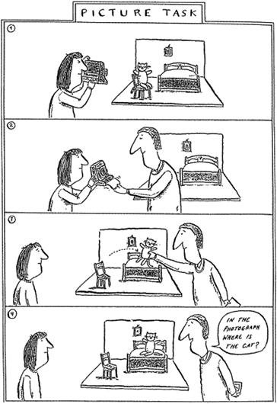
However...
?
a sofa with a cat,
somebody taking a photo,
the cat is replaced
What will the photo show?

Slide 23
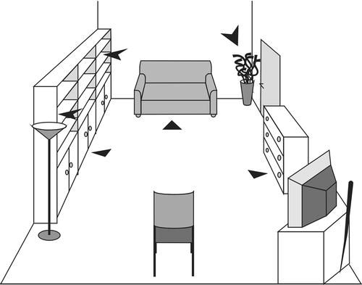
Theory of mind
A nonverbal test of knowledge attribution: a comparative study on dogs and children
Zs. Virányi, J. Topál, Á. Miklósi, V. Csányi
Animal Cognition, Volume 9, Issue 1, pp 13–26 (2006)
?
The experiment took place in a room of the subject’s home. The picture shows one example. In the foreground a chair is positioned for the Helper and the stick is in its usual place (behind the TV). In the background, on the right side the door can be seen where the participants can enter and leave the room. The triangles sign the hiding places for the toy (▴) and for the stick (➤): three-three out-of-reach hiding places for both of the objects

Slide 24
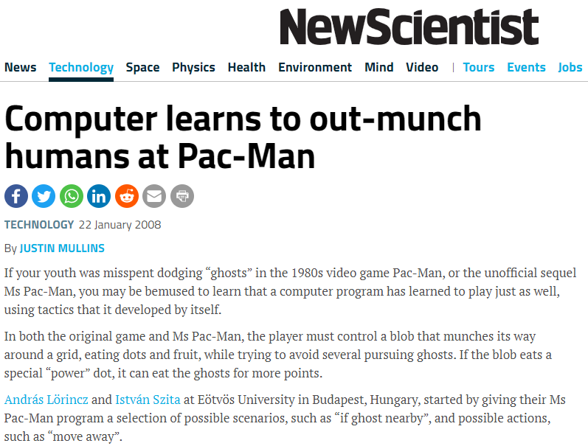

Examples
Comment:
Are you people crazy?
Why are you training a computer for playing PacMan instead of playing it?

Slide 25
Thank you
for your
attention!
lorincz@inf.elte.hu

Slide 26
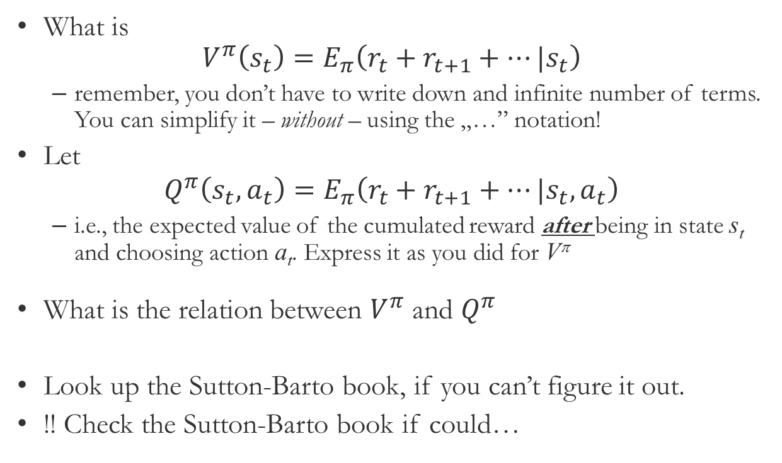
Homeworks
What is ${V^{π}\left(s_{t}\right)=E}_{π}\left(r_{t}+r_{t+1}+…|s_{t}\right)$
remember, you don’t have to write down and infinite number of terms. You can simplify it – without – using the „…” notation!
Let
$${Q^{π}\left(s_{t},a_{t}\right)=E}_{π}\left(r_{t}+r_{t+1}+…|s_{t},a_{t}\right)$$
i.e., the expected value of the cumulated reward after being in state s_{t} and choosing action a_{t}. Express it as you did for V^{π}
What is the relation between $V^{π}$ and $Q^{π}$
Look up the Sutton-Barto book, if you can’t figure it out.
!! Check the Sutton-Barto book if could…

Slide 27
Typical questions at the exam
What are the elements of the simplest goal-oriented system?
What are the features of the strategy?
Can complex movement program be inherited?
What is called „False Belief”?
What is the Markov assumption? (A system that fulfills the Markov assumption is said to have the Markov property.)
List features that corrupt the Markov property?
How can you improve the Markov property?

